Slide 1


Machine Learning 7. Softmax Regression
Xueyuan Gong
School of Intelligent Systems Science and Engineering

Slide 2
Classification
Binary classification: predicting a binary-valued target
Multiclass classification: predicting a discrete(> 2)-valued target
Examples of multi-class classification
Predict the value of a handwritten digit
classify e-mails as spam, travel, work, personal

Slide 3
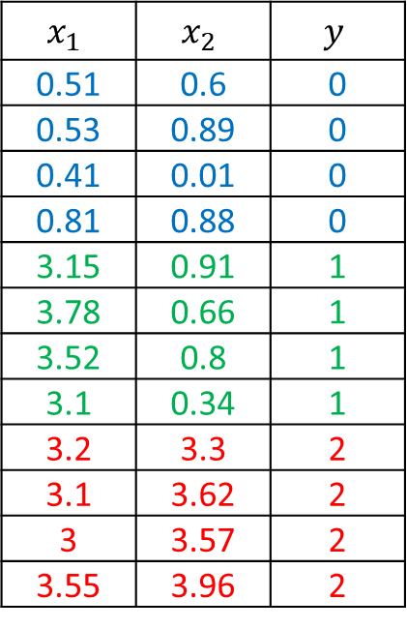
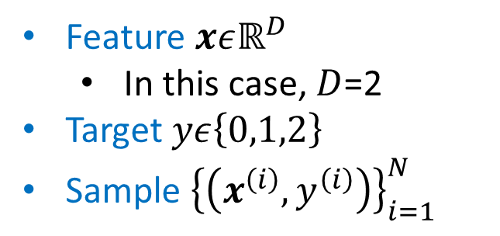
Multi-class classification
Dataset
Feature $xεℝ^{D}$
In this case, $D$=2
Target $yε\left\{0,1,2\right\}$
Sample ${\left\{\left(x^{\left(i\right)},y^{\left(i\right)}\right)\right\}}_{i=1}^{N}$
$$x_{1}$$ | $$x_{2}$$ | $$y$$
0.51 | 0.6 | 0
0.53 | 0.89 | 0
0.41 | 0.01 | 0
0.81 | 0.88 | 0
3.15 | 0.91 | 1
3.78 | 0.66 | 1
3.52 | 0.8 | 1
3.1 | 0.34 | 1
3.2 | 3.3 | 2
3.1 | 3.62 | 2
3 | 3.57 | 2
3.55 | 3.96 | 2

Slide 4
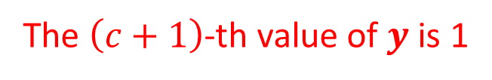
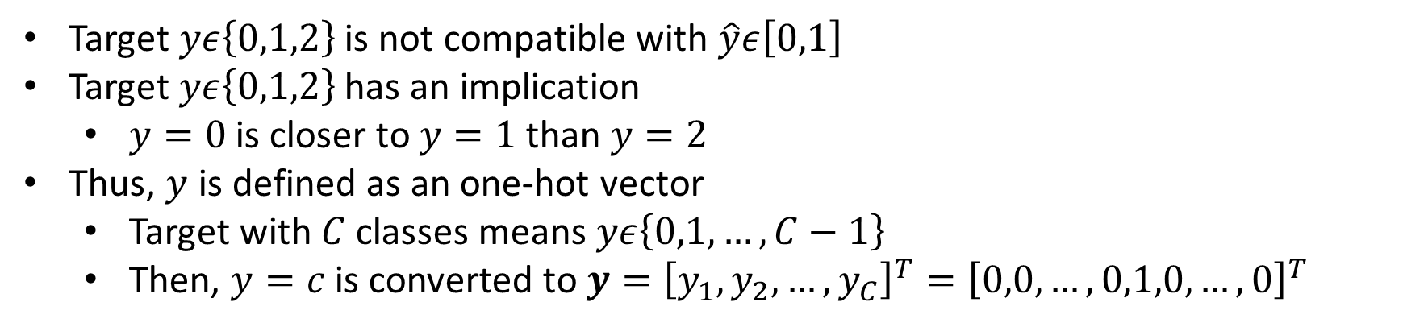
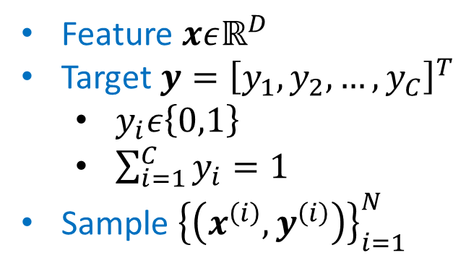
One-hot Vector
Target $yε\left\{0,1,2\right\}$ is not compatible with $\hat{y}ε\left[0,1\right]$
Target $yε\left\{0,1,2\right\}$ has an implication
$y=0$ is closer to $y=1$ than $y=2$
Thus, $y$ is defined as an one-hot vector
Target with $C$ classes means $yε\left\{0,1,…,C−1\right\}$
Then, $y=c$ is converted to $y={\left[y_{1},y_{2},…,y_{C}\right]}^{T}={\left[0,0,…,0,1,0,…,0\right]}^{T}$
Feature $xεℝ^{D}$
Target $y={\left[y_{1},y_{2},…,y_{C}\right]}^{T}$
$y_{i}ε\left\{0,1\right\}$
$\sum_{i=1}^{C}{y_{i}}=1$
Sample ${\left\{\left(x^{\left(i\right)},y^{\left(i\right)}\right)\right\}}_{i=1}^{N}$
The $\left(c+1\right)$-th value of $y$ is 1

Slide 5
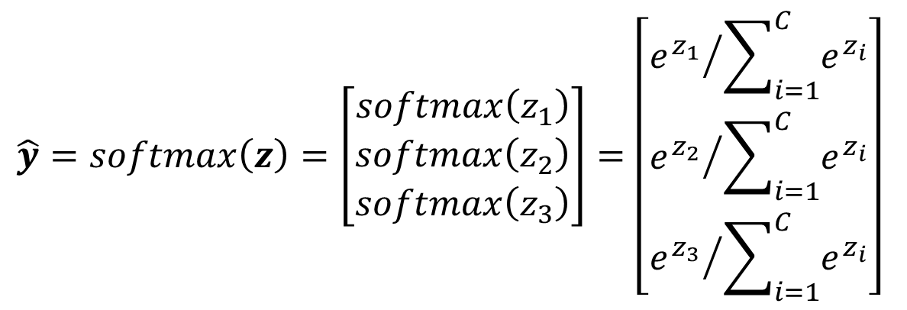
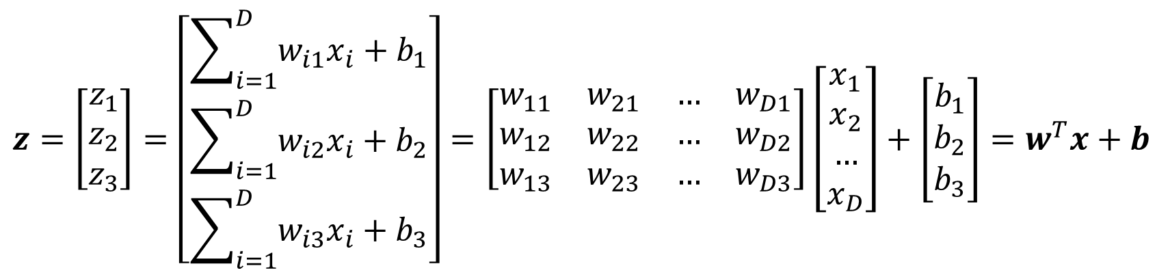
Softmax Regression
Model
$$z=\left[\begin{matrix}z_{1} \\ z_{2} \\ z_{3}\end{matrix}\right]=\left[\begin{matrix}\sum_{i=1}^{D}{w_{i1}x_{i}+b_{1}} \\ \sum_{i=1}^{D}{w_{i2}x_{i}+b_{2}} \\ \sum_{i=1}^{D}{w_{i3}x_{i}+b_{3}}\end{matrix}\right]=\left[\begin{matrix}w_{11} & w_{21} & … & w_{D1} \\ w_{12} & w_{22} & … & w_{D2} \\ w_{13} & w_{23} & … & w_{D3}\end{matrix}\right]\left[\begin{matrix}x_{1} \\ x_{2} \\ … \\ x_{D}\end{matrix}\right]+\left[\begin{matrix}b_{1} \\ b_{2} \\ b_{3}\end{matrix}\right]=w^{T}x+b$$
$$\hat{y}=softmax\left(z\right)=\left[\begin{matrix}softmax\left(z_{1}\right) \\ softmax\left(z_{2}\right) \\ softmax\left(z_{3}\right)\end{matrix}\right]=\left[\begin{matrix}{e^{z_{1}}}/{\sum_{i=1}^{C}{e^{z_{i}}}} \\ {e^{z_{2}}}/{\sum_{i=1}^{C}{e^{z_{i}}}} \\ {e^{z_{3}}}/{\sum_{i=1}^{C}{e^{z_{i}}}}\end{matrix}\right]$$

Slide 6
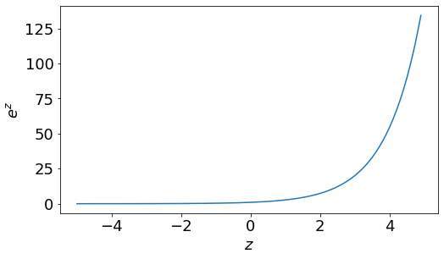
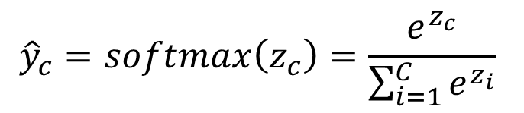
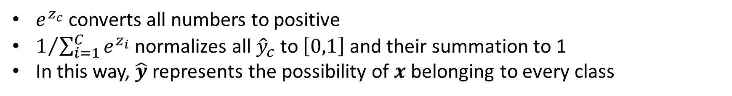
Softmax Function
$${\hat{y}}_{c}=softmax\left(z_{c}\right)=\frac{e^{z_{c}}}{\sum_{i=1}^{C}{e^{z_{i}}}}$$
$e^{z_{c}}$ converts all numbers to positive
$1/{\sum_{i=1}^{C}{e^{z_{i}}}}$ normalizes all ${\hat{y}}_{c}$ to $\left[0,1\right]$ and their summation to 1
In this way, $\hat{y}$ represents the possibility of $x$ belonging to every class

Slide 7

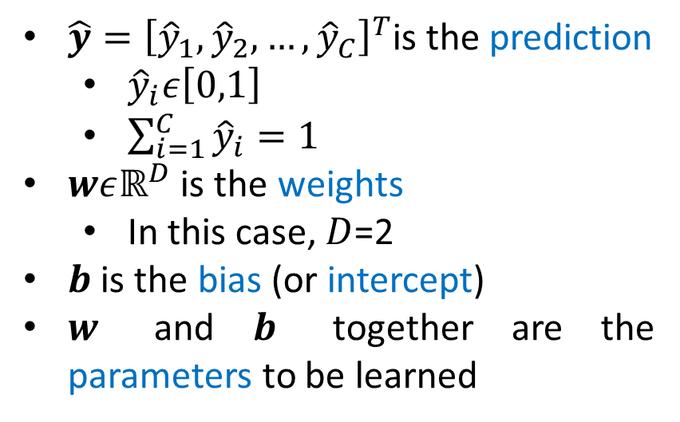
Softmax Regression
Model
$$\hat{y}=Softmax\left(z\right)=Softmax\left(w^{T}x+b\right)$$
$\hat{y}{=\left[{\hat{y}}_{1},{\hat{y}}_{2},…,{\hat{y}}_{C}\right]}^{T}$is the prediction
${\hat{y}}_{i}ε\left[0,1\right]$
$\sum_{i=1}^{C}{{\hat{y}}_{i}}=1$
$wεℝ^{D}$ is the weights
In this case, $D$=2
$b$ is the bias (or intercept)
$w$ and $b$ together are the parameters to be learned

Slide 8
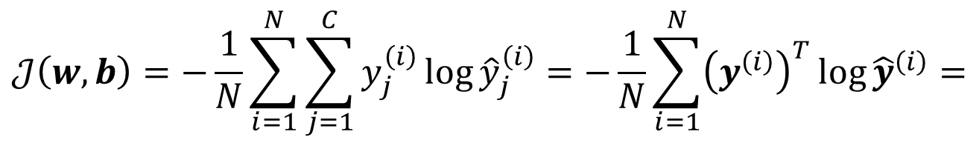
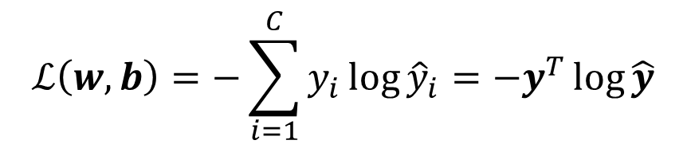
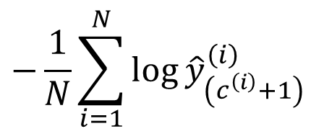

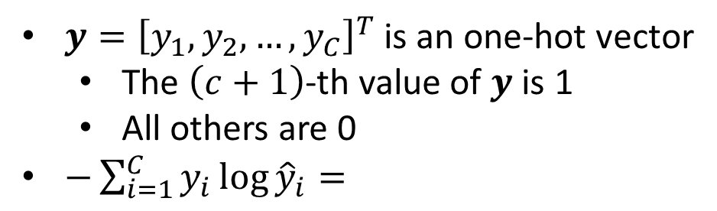
Cost Function
Loss Function
$y{=\left[y_{1},y_{2},…,y_{C}\right]}^{T}$ is an one-hot vector
The $\left(c+1\right)$-th value of $y$ is 1
All others are 0
$−\sum_{i=1}^{C}{y_{i}\log{{\hat{y}}_{i}}}=$
$$ℒ\left(w,b\right)=−\sum_{i=1}^{C}{y_{i}\log{{\hat{y}}_{i}}}=−y^{T}\log{\hat{y}}$$
$$−\log{{\hat{y}}_{\left(c+1\right)}}$$
Cost Function
$$𝒥\left(w,b\right)=−\frac{1}{N}\sum_{i=1}^{N}{\sum_{j=1}^{C}{y_{j}^{\left(i\right)}\log{{\hat{y}}_{j}^{\left(i\right)}}}}=−\frac{1}{N}\sum_{i=1}^{N}{{\left(y^{\left(i\right)}\right)}^{T}\log{{\hat{y}}^{\left(i\right)}}}=$$
$$−\frac{1}{N}\sum_{i=1}^{N}{\log{{\hat{y}}_{\left(c^{\left(i\right)}+1\right)}^{\left(i\right)}}}$$
$ℒ\left(w,b\right)$ is called Cross Entropy, which is equivalent to Binary Cross Entropy

Slide 9


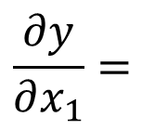

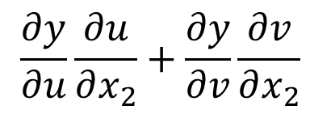





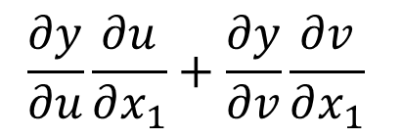


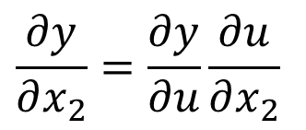


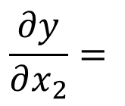
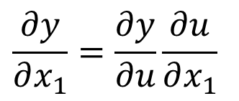


Partial Derivatives of Composite Functions
Chain rule of univariate composite functions
$$x_{1}$$
$$y=f\left(u\right)$$
$$u=u\left(x_{1},x_{2}\right)$$
$$u$$
$$y$$
$$\frac{∂y}{∂x_{1}}=\frac{∂y}{∂u}\frac{∂u}{∂x_{1}}$$
$$\frac{∂y}{∂x_{2}}=\frac{∂y}{∂u}\frac{∂u}{∂x_{2}}$$
$$x_{2}$$
Chain rule of multivariate composite functions
$$y=f\left(u,v\right)$$
$$u=u\left(x_{1},x_{2}\right)$$
$$v=v\left(x_{1},x_{2}\right)$$
$$x_{1}$$
$$u$$
$$y$$
$$\frac{∂y}{∂x_{1}}=$$
$$\frac{∂y}{∂u}\frac{∂u}{∂x_{1}}+\frac{∂y}{∂v}\frac{∂v}{∂x_{1}}$$
$$\frac{∂y}{∂x_{2}}=$$
$$\frac{∂y}{∂u}\frac{∂u}{∂x_{2}}+\frac{∂y}{∂v}\frac{∂v}{∂x_{2}}$$
$$x_{2}$$
$$v$$

Slide 10

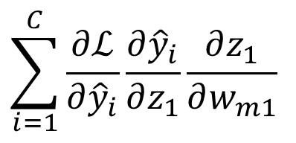
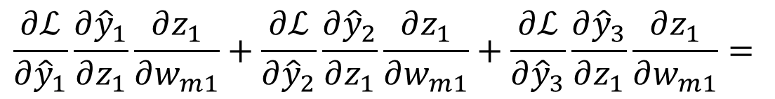


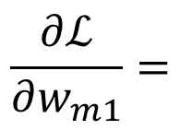
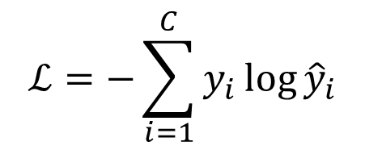

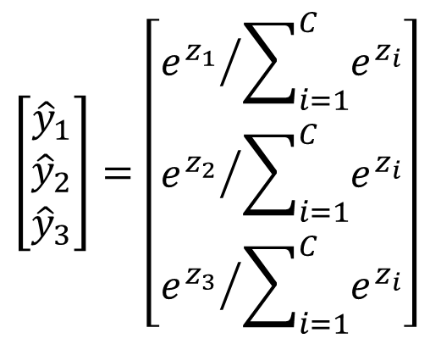
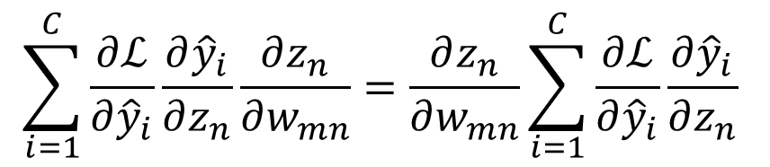

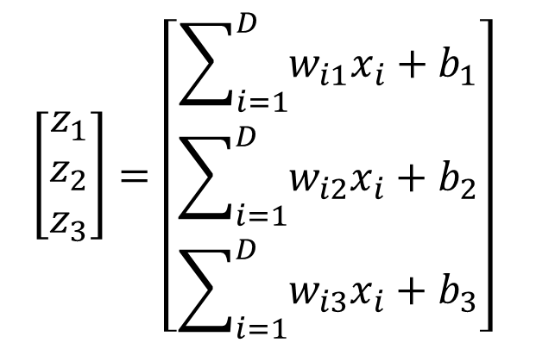

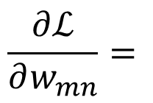
Gradient Descent
$${\hat{y}}_{1}$$
$$w_{m1}$$
$$z_{1}$$
$${\hat{y}}_{2}$$
$$ℒ$$
Model
$${\hat{y}}_{3}$$
$$\left[\begin{matrix}z_{1} \\ z_{2} \\ z_{3}\end{matrix}\right]=\left[\begin{matrix}\sum_{i=1}^{D}{w_{i1}x_{i}+b_{1}} \\ \sum_{i=1}^{D}{w_{i2}x_{i}+b_{2}} \\ \sum_{i=1}^{D}{w_{i3}x_{i}+b_{3}}\end{matrix}\right]$$
$$\left[\begin{matrix}{\hat{y}}_{1} \\ {\hat{y}}_{2} \\ {\hat{y}}_{3}\end{matrix}\right]=\left[\begin{matrix}{e^{z_{1}}}/{\sum_{i=1}^{C}{e^{z_{i}}}} \\ {e^{z_{2}}}/{\sum_{i=1}^{C}{e^{z_{i}}}} \\ {e^{z_{3}}}/{\sum_{i=1}^{C}{e^{z_{i}}}}\end{matrix}\right]$$
$$ℒ=−\sum_{i=1}^{C}{y_{i}\log{{\hat{y}}_{i}}}$$
$$\sum_{i=1}^{C}{\frac{∂ℒ}{∂{\hat{y}}_{i}}\frac{∂{\hat{y}}_{i}}{∂z_{1}}\frac{∂z_{1}}{∂w_{m1}}}$$
$$\frac{∂ℒ}{∂w_{m1}}=$$
$$\frac{∂ℒ}{∂{\hat{y}}_{1}}\frac{∂{\hat{y}}_{1}}{∂z_{1}}\frac{∂z_{1}}{∂w_{m1}}+\frac{∂ℒ}{∂{\hat{y}}_{2}}\frac{∂{\hat{y}}_{2}}{∂z_{1}}\frac{∂z_{1}}{∂w_{m1}}+\frac{∂ℒ}{∂{\hat{y}}_{3}}\frac{∂{\hat{y}}_{3}}{∂z_{1}}\frac{∂z_{1}}{∂w_{m1}}=$$
$$\frac{∂ℒ}{∂w_{mn}}=$$
$$\sum_{i=1}^{C}{\frac{∂ℒ}{∂{\hat{y}}_{i}}\frac{∂{\hat{y}}_{i}}{∂z_{n}}\frac{∂z_{n}}{∂w_{mn}}}=\frac{∂z_{n}}{∂w_{mn}}\sum_{i=1}^{C}{\frac{∂ℒ}{∂{\hat{y}}_{i}}\frac{∂{\hat{y}}_{i}}{∂z_{n}}}$$

Slide 11
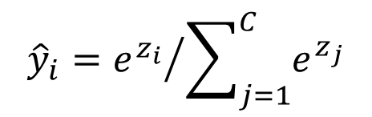
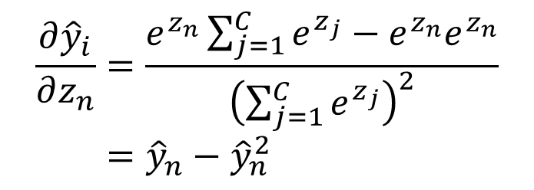
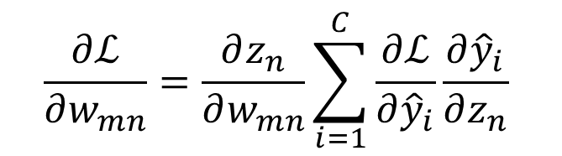
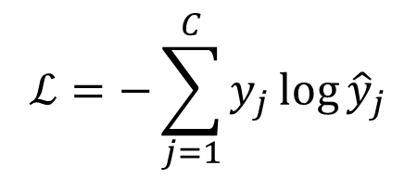
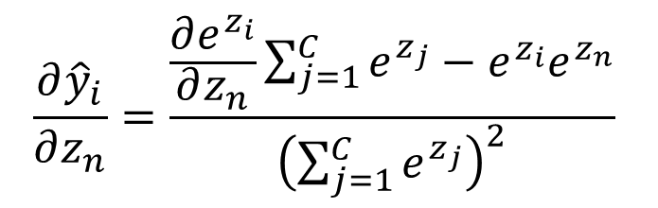
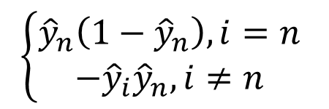
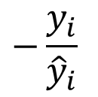
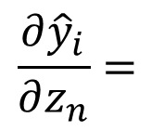
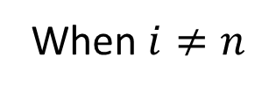
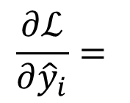

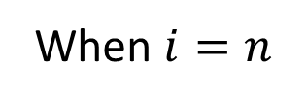
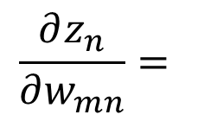
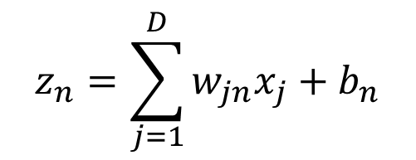
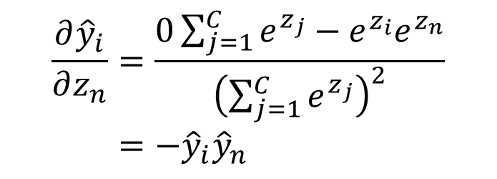
Gradient Descent
$$\frac{∂{\hat{y}}_{i}}{∂z_{n}}=\frac{\frac{∂e^{z_{i}}}{∂z_{n}}\sum_{j=1}^{C}{e^{z_{j}}}−e^{z_{i}}e^{z_{n}}}{{\left(\sum_{j=1}^{C}{e^{z_{j}}}\right)}^{2}}$$
$$\frac{∂ℒ}{∂w_{mn}}=\frac{∂z_{n}}{∂w_{mn}}\sum_{i=1}^{C}{\frac{∂ℒ}{∂{\hat{y}}_{i}}\frac{∂{\hat{y}}_{i}}{∂z_{n}}}$$
When $i=n$
$$z_{n}=\sum_{j=1}^{D}{w_{jn}x_{j}+b_{n}}$$
$$\frac{∂z_{n}}{∂w_{mn}}=$$
$$\frac{∂{\hat{y}}_{i}}{∂z_{n}}=\frac{e^{z_{n}}\sum_{j=1}^{C}{e^{z_{j}}}−e^{z_{n}}e^{z_{n}}}{{\left(\sum_{j=1}^{C}{e^{z_{j}}}\right)}^{2}}={\hat{y}}_{n}−{\hat{y}}_{n}^{2}$$
$$x_{m}$$
$$ℒ=−\sum_{j=1}^{C}{y_{j}\log{{\hat{y}}_{j}}}$$
$$\frac{∂ℒ}{∂{\hat{y}}_{i}}=$$
$$−\frac{y_{i}}{{\hat{y}}_{i}}$$
When $i≠n$
$$\frac{∂{\hat{y}}_{i}}{∂z_{n}}=\frac{0\sum_{j=1}^{C}{e^{z_{j}}}−e^{z_{i}}e^{z_{n}}}{{\left(\sum_{j=1}^{C}{e^{z_{j}}}\right)}^{2}}=−{\hat{y}}_{i}{\hat{y}}_{n}$$
$${\hat{y}}_{i}={e^{z_{i}}}/{\sum_{j=1}^{C}{e^{z_{j}}}}$$
$$\frac{∂{\hat{y}}_{i}}{∂z_{n}}=$$
$$\left\{\begin{aligned}{\hat{y}}_{n}\left(1−{\hat{y}}_{n}\right), i=n \\ −{\hat{y}}_{i}{\hat{y}}_{n},i≠n\end{aligned}\right.$$

Slide 12
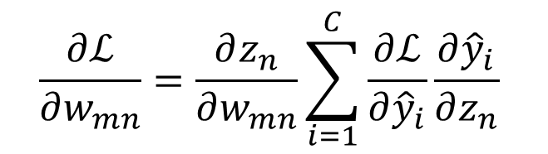
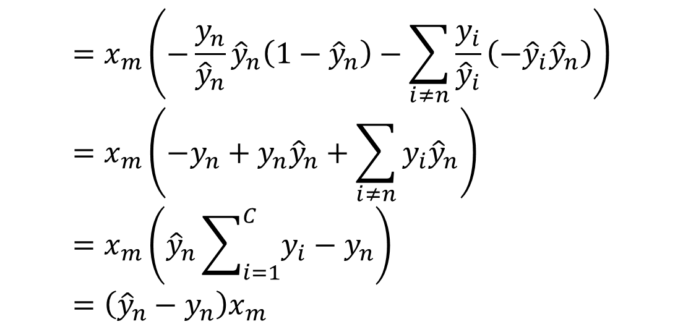
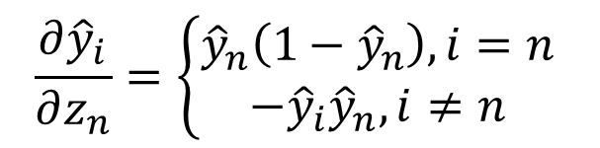
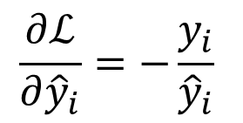
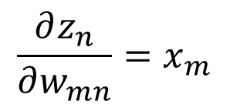
Gradient Descent
$$\frac{∂ℒ}{∂w_{mn}}=\frac{∂z_{n}}{∂w_{mn}}\sum_{i=1}^{C}{\frac{∂ℒ}{∂{\hat{y}}_{i}}\frac{∂{\hat{y}}_{i}}{∂z_{n}}}$$
$$\frac{∂z_{n}}{∂w_{mn}}=x_{m}$$
$$\frac{∂ℒ}{∂{\hat{y}}_{i}}=−\frac{y_{i}}{{\hat{y}}_{i}}$$
$$=x_{m}\left(−\frac{y_{n}}{{\hat{y}}_{n}}{\hat{y}}_{n}\left(1−{\hat{y}}_{n}\right)−\sum_{i≠n}{\frac{y_{i}}{{\hat{y}}_{i}}\left(−{\hat{y}}_{i}{\hat{y}}_{n}\right)}\right)=x_{m}\left(−y_{n}+y_{n}{\hat{y}}_{n}+\sum_{i≠n}{y_{i}{\hat{y}}_{n}}\right)=x_{m}\left({\hat{y}}_{n}\sum_{i=1}^{C}{y_{i}}−y_{n}\right)=\left({\hat{y}}_{n}−y_{n}\right)x_{m}$$
$$\frac{∂{\hat{y}}_{i}}{∂z_{n}}=\left\{\begin{aligned}{\hat{y}}_{n}\left(1−{\hat{y}}_{n}\right), i=n \\ −{\hat{y}}_{i}{\hat{y}}_{n},i≠n\end{aligned}\right.$$

Slide 13
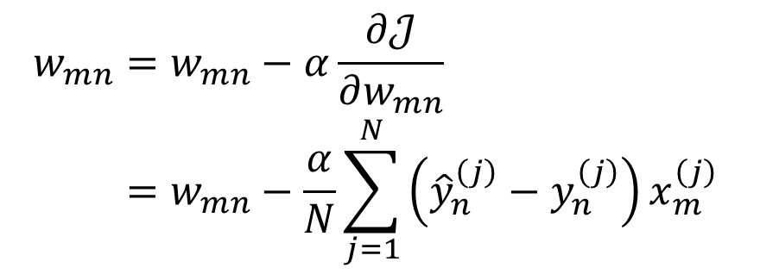

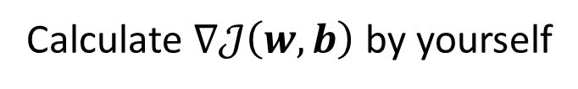





Summary
Model
$$z=w^{T}x+b$$
$$\hat{y}=Softmax\left(z\right)$$
$$ℒ\left(w,b\right)=−y^{T}\log{\hat{y}}$$
Calculate Gradient
$$\frac{∂ℒ}{∂w_{mn}}=\left({\hat{y}}_{n}−y_{n}\right)x_{m}$$
$$\frac{∂ℒ}{∂b_{n}}=\left({\hat{y}}_{n}−y_{n}\right)$$
Calculate $∇𝒥\left(w,b\right)$ by yourself
Update
$$w_{mn}=w_{mn}−α\frac{∂𝒥}{∂w_{mn}}=w_{mn}−\frac{α}{N}\sum_{j=1}^{N}{\left({\hat{y}}_{n}^{\left(j\right)}−y_{n}^{\left(j\right)}\right)x_{m}^{\left(j\right)}}$$
$$b_{n}=b_{n}−α\frac{∂𝒥}{∂b_{n}}=b_{n}−\frac{α}{N}\sum_{j=1}^{N}{\left({\hat{y}}_{n}^{\left(j\right)}−y_{n}^{\left(j\right)}\right)}$$

Slide 14

*K Nearest Neighbors
There are also other classification methods
K Nearest Neighbors (KNN) is an easy one
Given a test sample $x$
Count its K nearest neighbors
Then $x$ belongs to the class that most neighbors belong to

Slide 15
Thank you！

